Slide 1



INTELLIGENCE REPORTS ANALYSIS
Presented By:
1. Sufiyan Abdullah Ghori Mohammed (Z2037215)
2. Minhaz Patel (Z1961329)
3. Sai Sindhu Dandibhatla (Z2024036)
4. Subikshaa Ramachandran (Z2043616)
5. Isabel Galla (Z1975679)

Slide 2









Key Questions

Slide 3

Preliminary Findings
Interconnected Reports - Understanding the chronological sequence of reports is crucial for contextualizing the threat narrative.
Alias Identification - Some reports explicitly mention aliases, while others require inference from contextual clues.
Establishing a Baseline Metric - A comparison metric is essential to evaluate suspects, places, organizations, and temporal patterns across reports.

Slide 4

Computational Technique
Threat Score - Calculated using both the number and ranking of dangerous keywords, as well as the presence of strategic locations within each report.
With this method, we are now ready with report-level threat scores.
Next, to generate the suspect list, we aggregated and unified suspect identities using alias mapping. This enabled us to assign overall threat scores to each unique suspect and rank them accordingly.
threat_score = w1 × max_place_score + w2 × avg_danger_score

Slide 5

Computational Technique
We mapped suspects and their related files, and used LLMs via LangChain API to answer the remaining key questions.
Google's Gemini model API was utilized; custom prompts were crafted to obtain structured answers for "when," "where," and "what" aspects of planned threats.
For each suspect, all related files and tailored prompts were submitted to the model. Returned responses were extracted and organized for further analysis.

Slide 6

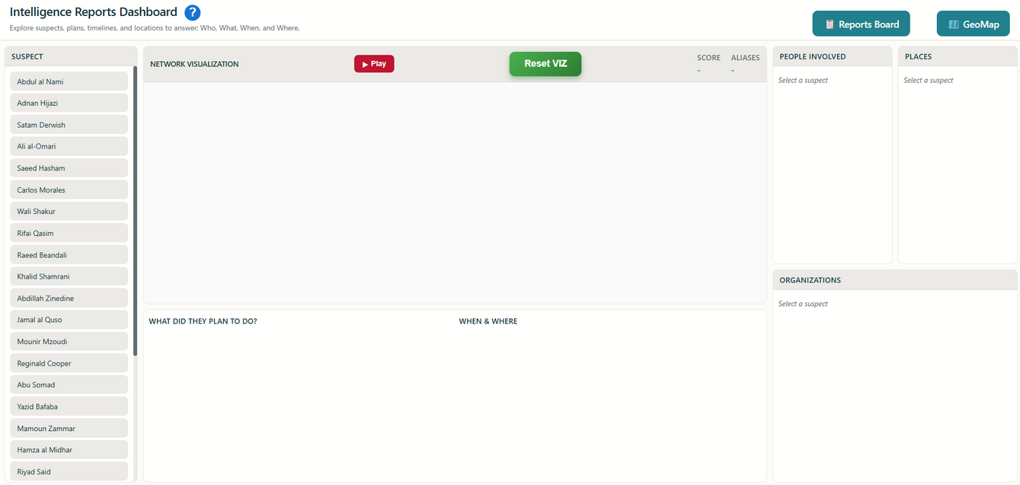
Web UI Design
When designing the interface, our primary focus was to prominently display the three key questions at the center of the user experience.

Slide 7
Additional UI Features
Reports Board
GeoMap
Reset Viz
Infotip

Slide 8
THANK YOU

Slide 9

Future Enhancements
CHAT LLM
RANKING MAPPINGS, ALIAS MAPPING
COMPUTATION TECHNIQUE
Input Data
Output Data
Current Architecture

Slide 10


AI AGENT 1
RANKING MAPPINGS, ALIAS MAPPING
CLOUD STORAGE
Input Data
AI AGENT 2
COMPUTATION TECHNIQUE
Output Data
SUPERVISOR AGENT
Proposed Architecture

